Slide 2

severe one tie to attach to another - Paul loved Timothy.

Slide 3
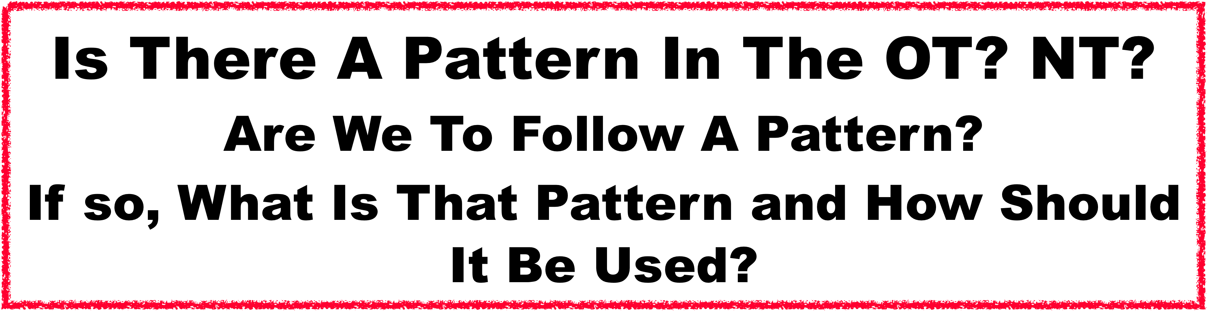

Slide 4
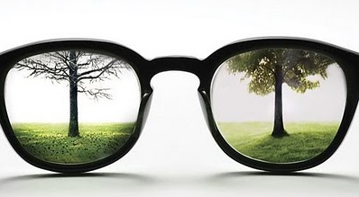
Reality & Perception…
“I Want To Know The Reality”
Francis “Smart” Banago

Slide 5
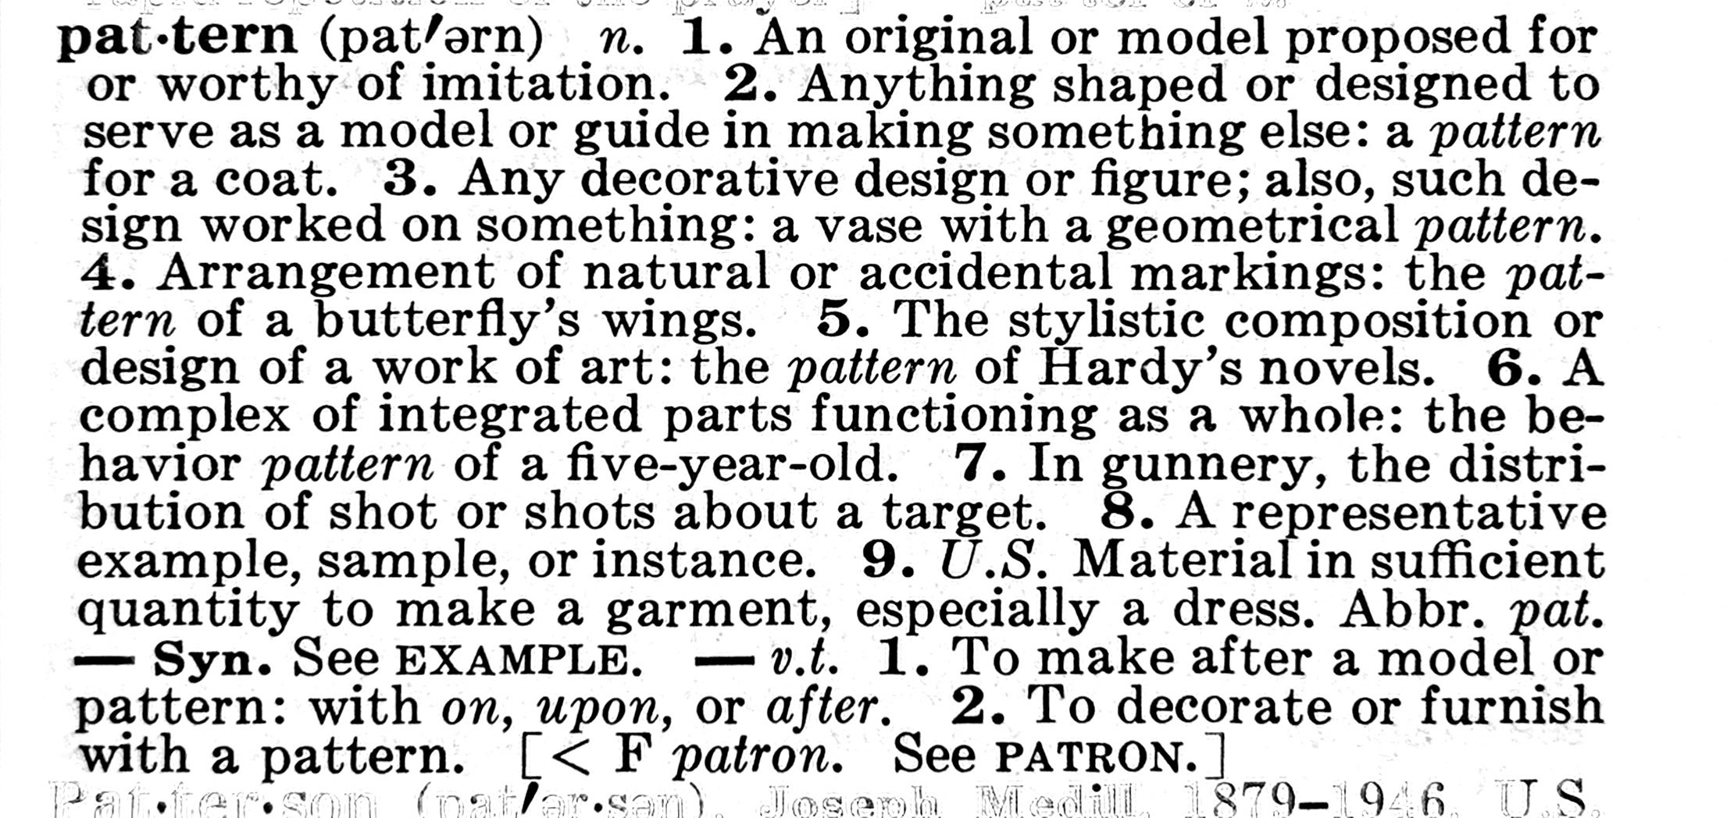
Definition

Slide 6
1 Pet. 3:20-21
Hebrews 9:24
Real Thing
People (Types of the Real)
Elijah and John the Baptist
Melchizedek and Jesus
Adam and Jesus
Moses and Jesus
Jonah and Jesus
David and Jesus
Anti-type
The Shadow
Or Copy
Events/Items (Types of the Real)
The Passover Lamb and Jesus
The Bronze Serpent and Jesus On Cross
Noah’s Ark and Baptism
The Manna and Jesus the Bread of Life
Tabernacle/Temple and Jesus/The Church
Wilderness Rock and Jesus Water of Life
Type
Hebrews
8:25; 9:24
Does Anyone Have The Right To Alter The Things Of God?

Slide 7


Change The Pattern…
What Is The Outcome…
Different
Result…
Fly’s Terrible

Slide 8
“…Most Criticism of “patterns” is little more than a smoke screen for rejecting the authority of precedent itself.”
Smith, p. 110-111.
“Contend For The Faith Once For All Delivered To The Saints.”
Jude 1:3
“For Those Who Perish…Did Not Receive the love of the truth…”
2 Thess. 2:10

Slide 9
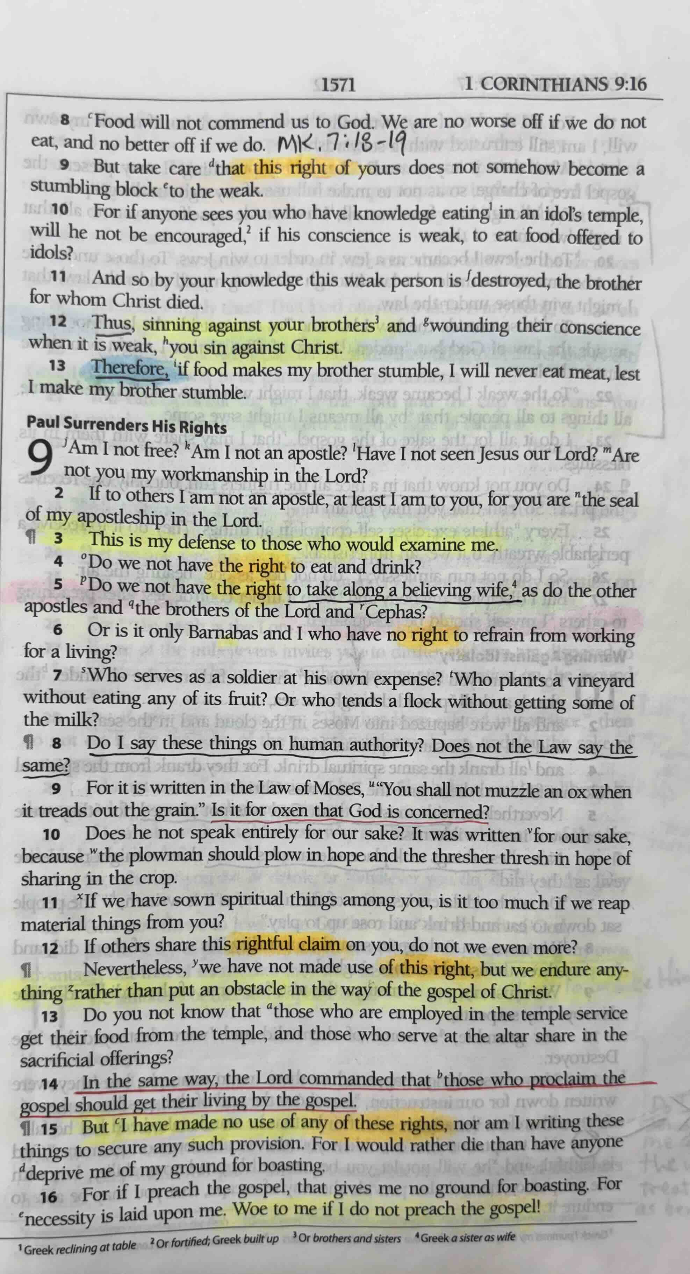
Paul’s Approach To
Doing The Will Of God.
“Right" Is The Word For
Authority. This Root Means
“It Is Lawful”.

Slide 10
Rules or Instruction In Communication.
Command
Example
Necessary Inference
  (Inescapable Conclusion)
  (Ex. Soldiers At River Civil War)
(CENI)

Slide 11
An Appeal To You…
Let’s Go Back To The Authority Of The Word Of God .
Let Us Make The Revealed Word Of God Our Pattern.
Every Generation That Will Do So Honestly - Can Restore It.
Some Want To Use Restoration Heritage As Authority…
“This Is What Has Been Done”.
Catholic Authority Claim:
Cf. Gnostic Diversity = Church Became Authority
Quotes Mid-1500’s: Protestant Splintering.
AI and Bob Reynolds Book

Slide 12
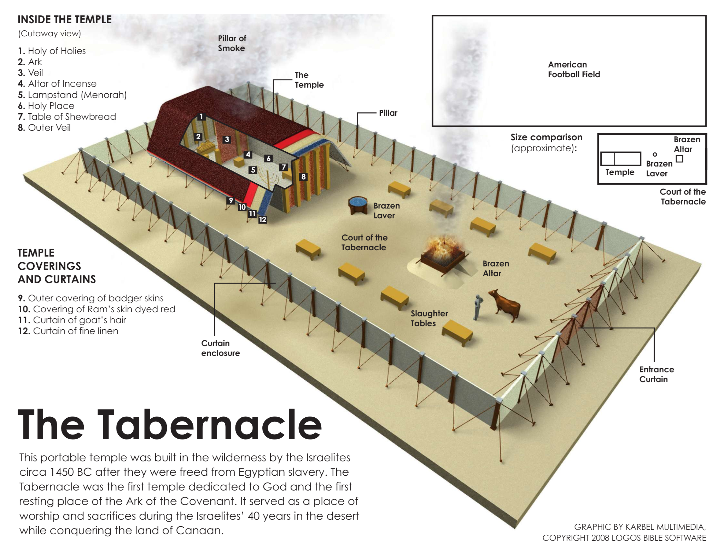
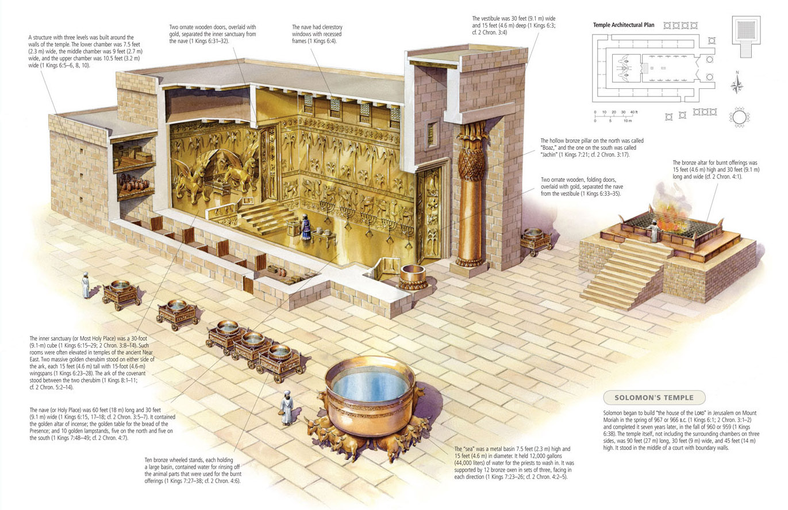

Haggai 2:1-9; Ezek. 40-48;
Eph. 2:21-22; 1 Cor. 3:16-17
Greater Temple Coming…
Jer. 7:8-15 What Happen At Shiloh?
Cf. 2 Chron. 24:13 (Joash); 2Kgs. 23:24-25 (Josiah)
According To The Pattern:
Exodus 25:9, 40; Hebrews 8:1-5; Acts 7:44; 1 Chronicles 28:19
Solomon’s Temple
Zerubbabel’s
Temple
Herod’s
Temple
Temple
Destroyed

Slide 13
Did It Matter How The Temple and Contents Were Made?
“All this, said David, “the LORD made me understand in writing by His hand upon me, all the details of this pattern.”
1 Chronicles 28:19

Slide 14
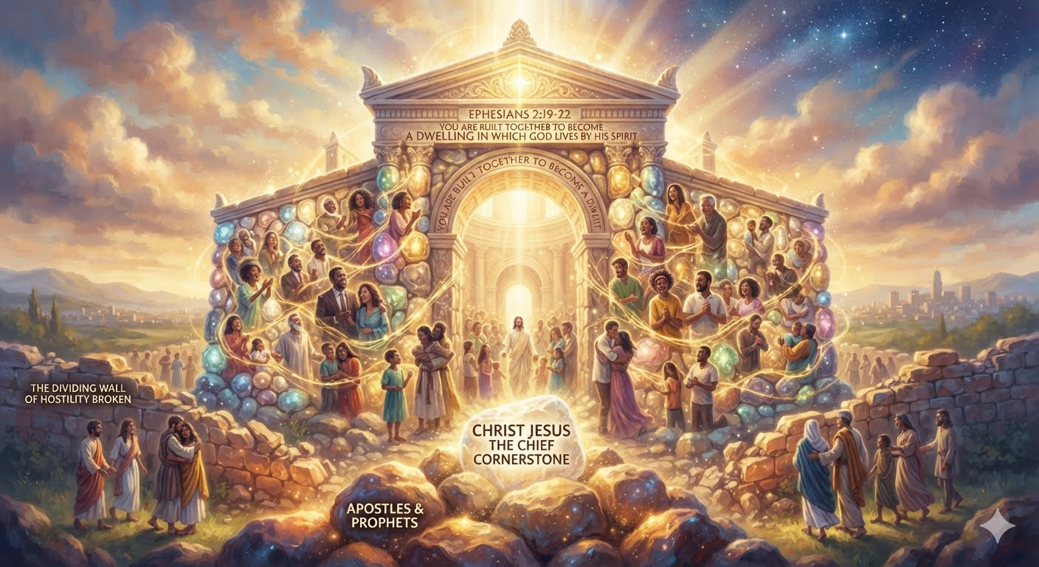
Does God Care About What His Temple Looks Like Today?

Slide 15
“Now if He were on earth, He would not be a priest at all, since there are those who offer the gifts according to the Law; Who serve a copy and shadow of the heavenly things, just as Moses was warned by God when he was about to erect the tabernacle; for, “SEE,” He says, “THAT YOU MAKE all things ACCORDING TO THE PATTERN WHICH WAS SHOWN YOU ON THE MOUNTAIN.”
Hebrews 8:4-5
According To The Pattern
#1 Had A Purpose #2 It Is The Lord’s

Slide 16
Does God Care About What His Temple Looks Like Today?
We Are Not Talking Just About A Physical Pattern…
But A Spiritual Pattern Of The Spiritual Temple That We Are.

Slide 17
(19) So then you are no longer strangers and aliens, but you are fellow citizens with the saints, and are of God’s household (20) having been built on the foundation of the apostles and prophets, Christ Jesus Himself being the corner stone, (21) in whom the whole building, being fitted together, is growing into a holy temple in the Lord, (22) in whom you also are being built together into a dwelling of God in the Spirit. Eph. 2:19-22
Temple…
(16) Do you not know that you are a temple of God and that the Spirit of God dwells in you? (17) If any man destroys the temple of God, God will destroy him, for the temple of God is holy, and that is what you are. 1 Cor. 3:16-17
Eph. 2:19-22
1 Cor. 3:16-17

Slide 18
Consider Ezekiel 40-48
(23) “Moreover, they shall teach My people the difference between the holy and the profane, and cause them to discern between the unclean and the clean. (24) “In a dispute they shall take their stand to judge; they shall judge it according to My ordinances. They shall also keep My laws and My statutes in all My appointed feasts and sanctify My sabbaths.
Ezekiel 44:23-24
Notes:
Ezekiel's_Temple Henry_Sulley's_rendering_of_

Slide 19
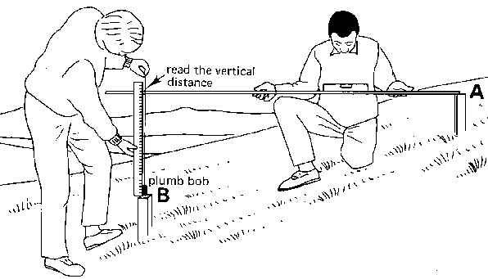
Measure Exactly…
Temple… (Ezek. 40:3-5)
Line of Flax
  (Plumb Bob? Way to Measure Larger Distances? Around Objects?)
Measuring Rod

Slide 20
(3) So He brought me there; and behold, there was a man whose appearance was like the appearance of bronze, with a line of flax and a measuring rod in his hand; and he was standing in the gateway.
4 The man said to me, “Son of man, see with your eyes, hear with your ears, and give attention to all that I am going to show you; for you have been brought here in order to show it to you. Declare to the house of Israel all that you see.”
Measurements Relating to the Temple
5 ¶ And behold, there was a wall on the outside of the temple all around, and in the man’s hand was a measuring rod of six cubits, each of which was a cubit and a handbreadth. So he measured the thickness of the wall, one rod; and the height, one rod.
Ezekiel 40:3-5

Slide 21
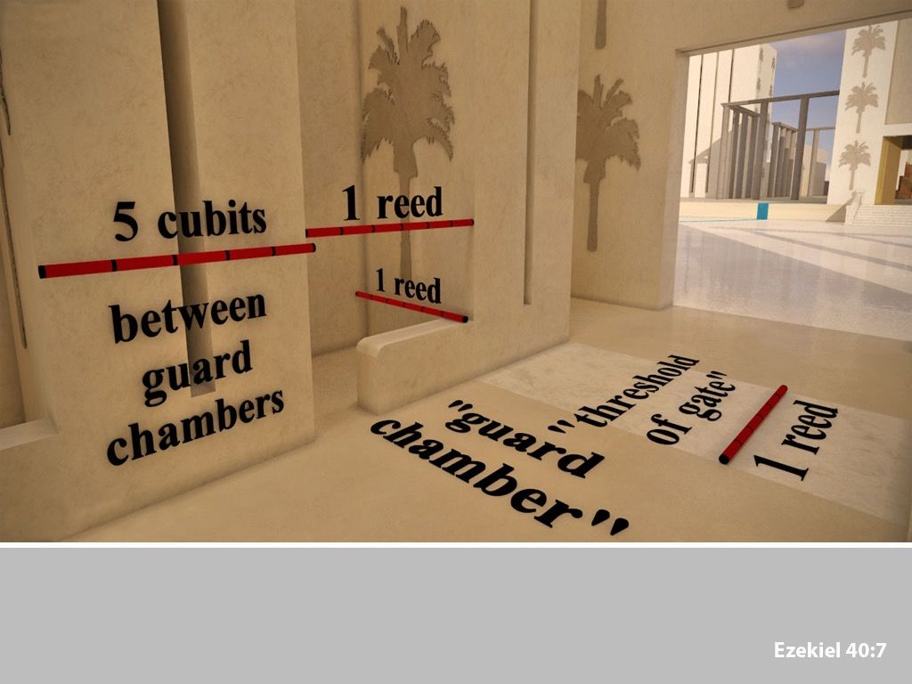
Temple…
Ezekiel 42:20
Holy and Profane

Slide 22
What Does The Word Copy Tell You?
(23) Therefore it was necessary for the copies of the things in the heavens to be cleansed with these, but the heavenly things themselves with better sacrifices than these. (24) For Christ did not enter a holy place made with hands, a mere copy of the true one, but into heaven itself, now to appear in the presence of God for us;
Hebrews 9:23-24
Physical Pattern (Blue Print) Of Physical Tabernacle and Temple
Spiritual Pattern (Blue Print) Of Spiritual Temple Of God

Slide 23

Titus 1:5
Acts 14:23 “Every Church” (Where Qualified)
Rev. 2-3
For this reason I have sent to you Timothy, who is my beloved and faithful child in the Lord, and he will remind you of my ways which are in Christ,
Just As I Teach
Everywhere In Every Church.
1 Corinthians 4:17
Same Directions To All
1 Cor. 7:17; 11:16;
14:33-34; 16:1-2
Read Same Letter
Col. 4:15-16

Slide 24
“Brethren, join in following my example, and observe those who walk according to the pattern you have in us.”
Philippians 3:17
Notes:
People look at “law keepers” and “self-righteous” people and want to through out the instruction of God and say… this “law keeper” mindset is not good so do what “I” want – My will be done. I don’t learn that from God’s word. Matt. 23:23 – These things you should have done and not left the others undone.

Slide 25


Philippians 1:8-10
(8) For God is my witness, how I long for you all with the affection of Christ Jesus. (9) And this I pray, that your love may abound still more and more in real knowledge and all discernment, (10) so that you may APPROVE the things that are excellent, in order to be SINCERE (ESV - pure) and blameless until the day of Christ.
“Tested By The Light Of The Sun, Completely Pure”
“Testing Things That Differ”
“Distinguish Differences”

Slide 26
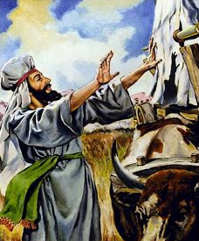
How Did Altering The Holy Things Of God Work Out For Uzzah?
2 Samuel 6:1-9

Slide 27
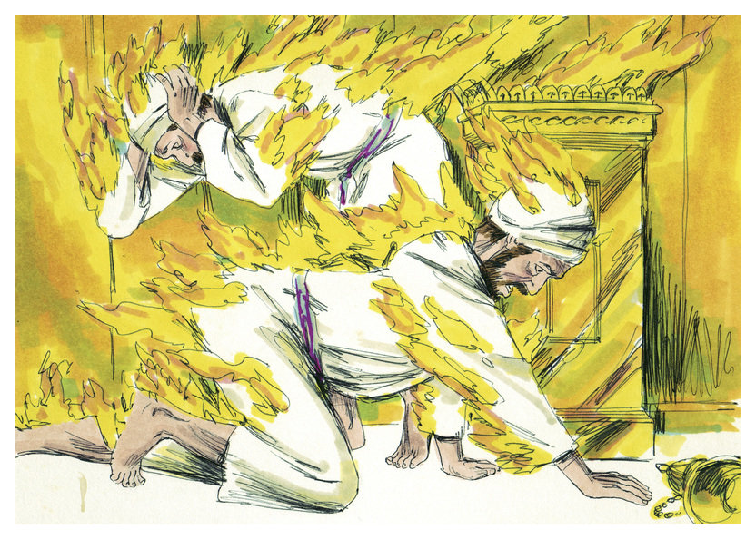
How Did Altering The Holy Things Of God Work Out For Nadab & Abihu??
Was God Pleased?
Leviticus 10

Slide 28
Neither A Completed Tabernacle By The Pattern nor A Completed Temple By The Pattern Were Pleasing To God - Unless The Faith Driven Relationship To God Was Intact.
Malachi 1-2
Isaiah 1:11-15
Jeremiah 7:12-15 Go To Shiloh
Notes:
People look at “law keepers” and “self-righteous” people and want to through out the instruction of God and say… this “law keeper” mindset is not good so do what “I” want – My will be done. I don’t learn that from God’s word. Matt. 23:23 – These things you should have done and not left the others undone.

Slide 29
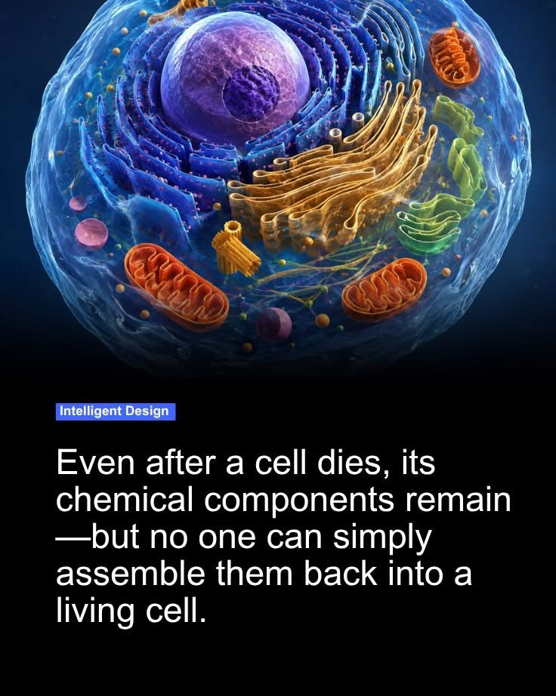

Not Only Does It Take
The Right Parts (Pattern)
But Also The Life or Spirit
That Gives That Pattern Life.
Example Of The Tabernacle:
The Right Parts And Materials
Were There But The Faith
And Spiritual Life -
Relationship To God Was Not.
Result?
Unacceptable To God!
Not Just The Parts But Also The Life That Gives It Life.

Slide 30
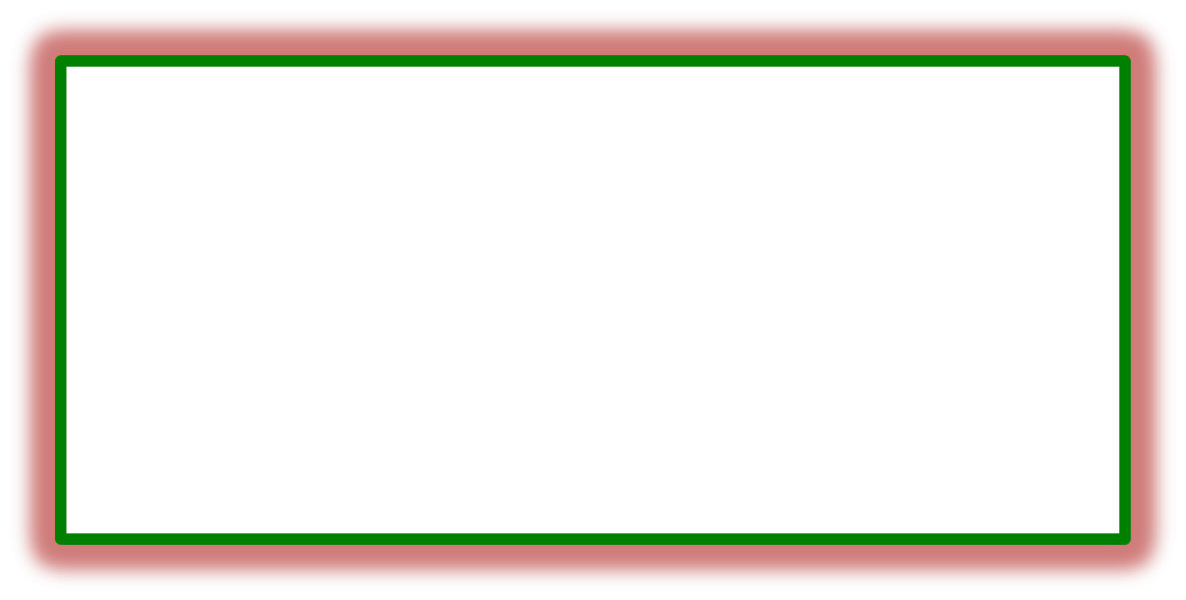
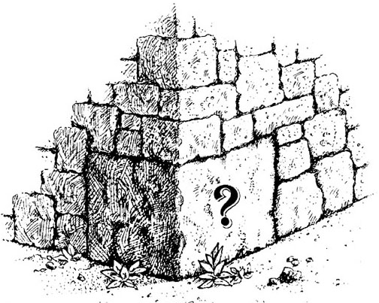
Eph. 2:20-21 (20) having been built on the foundation of the apostles and prophets, Christ Jesus Himself being the corner stone, (21) in whom the whole building, being fitted together, is growing into a holy temple in the Lord, (22) In whom you also are being built together into a dwelling of God in the Spirit.
Does The “Cornerstone” Matter?
Does The “Foundation” Matter?
Does The “Whole Building” Being Fitted Together Matter?
Does The “Temple” Matter?
To Me?
It Does To God… (vs. 22)
Notes:
Ezekiel's_Temple Henry_Sulley's_rendering_of_

Slide 31
(15) It is a trustworthy statement, deserving full acceptance, that Christ Jesus came into the world to save sinners, among whom I am foremost of all. (16) Yet for this reason I found mercy, so that in me as the foremost, Jesus Christ might demonstrate His perfect patience as an EXAMPLE for those who would believe in Him for eternal life. (17) Now to the King eternal, immortal, invisible, the only God, be honor and glory forever and ever. Amen.
1 Timothy 1:15-17
Notes:
People look at “law keepers” and “self-righteous” people and want to through out the instruction of God and say… this “law keeper” mindset is not good so do what “I” want – My will be done. I don’t learn that from God’s word. Matt. 23:23 – These things you should have done and not left the others undone.

Slide 32
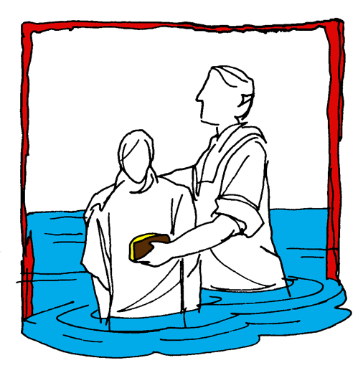

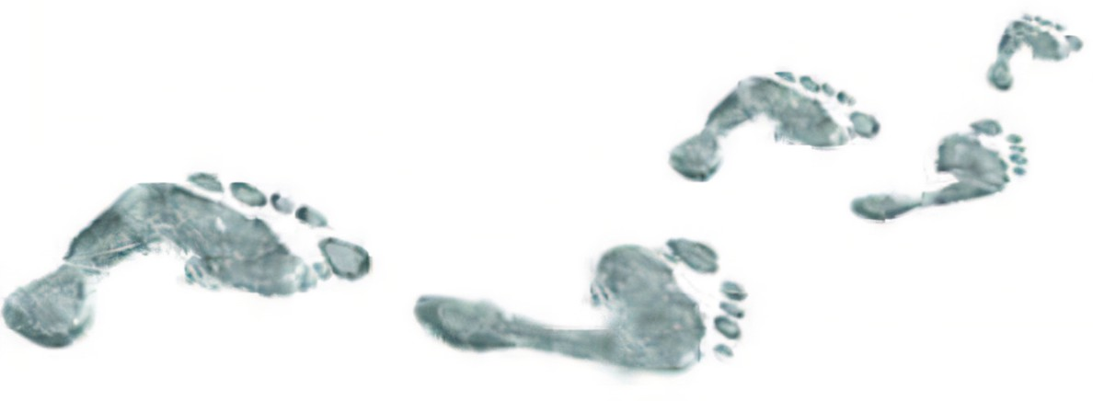
Hear (Rom. 10:17)
Believe (Jn. 8:24)
Repent (Acts 2:38)
Confess (Mt. 10:32-33)
Baptism (Acts 22:16)
Mk. 16:
15-16
Continue… (Matt. 28:20)
Committed To Follow Jesus

